Slide 1
Case Study - Cyclistic Bike Share
How do annual members and casual riders use Cyclistic bikes differently?
By - Ansari Mohd Ali
Date - 16-06-2021

Slide 2
Table of contents
Problem Statement
About dataset
Insights
Recommendation/ Suggestions
Appendix

Slide 3
Problem Statement
Cyclistics bike sharing wants to aimed at casual riders to convert them into annual members so our part of the goal is to analyse the difference between casual and annual riders bike usage and also suggest some recommendations.

Slide 4
About Dataset
Cyclistic’s historical trip data contains the details about start station and end station and bike details from 2016 to 2021(since 2016 is the start year of the company) which we have used in order of solve our goal
You can check the dataset here - Click here

Slide 5
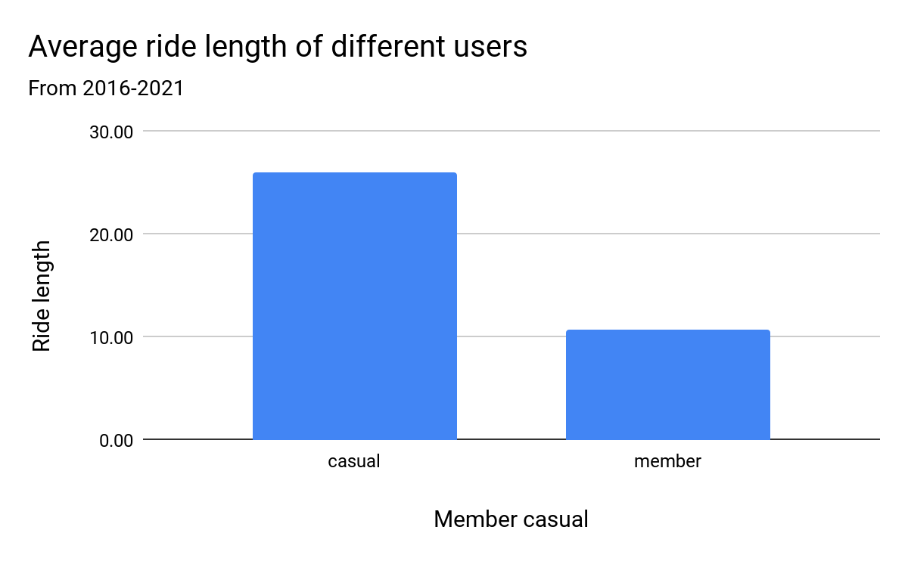
Insights - 1
Ride length is the difference between start time and end time of a trip
The average ride length of casual user is more than double the member so casual users use bike more than the member

Slide 6
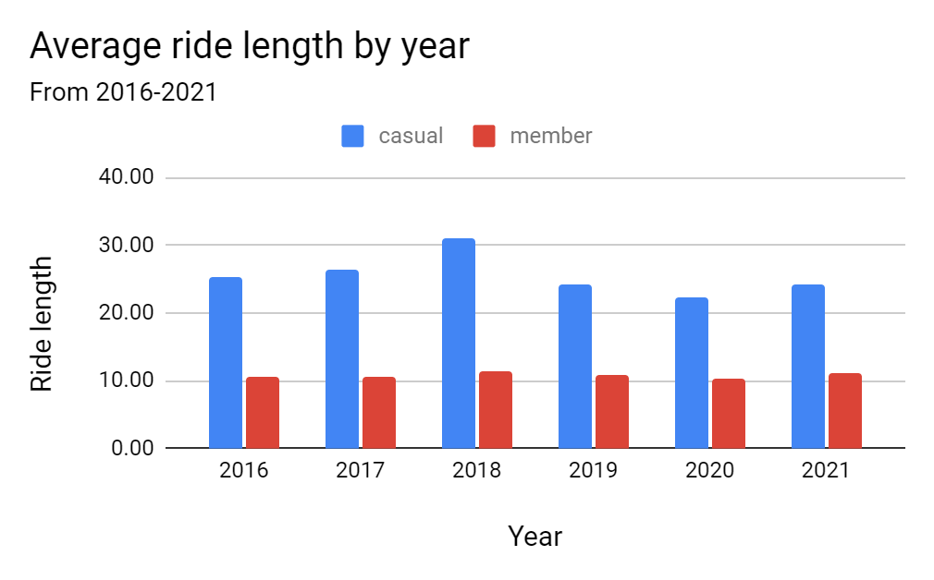
Insights - 2
If we go through year wise then also casual member are using more bikes than the members
Casual member finds it affordable to use bikes for every work thereby using buying and using bike passes daily

Slide 7
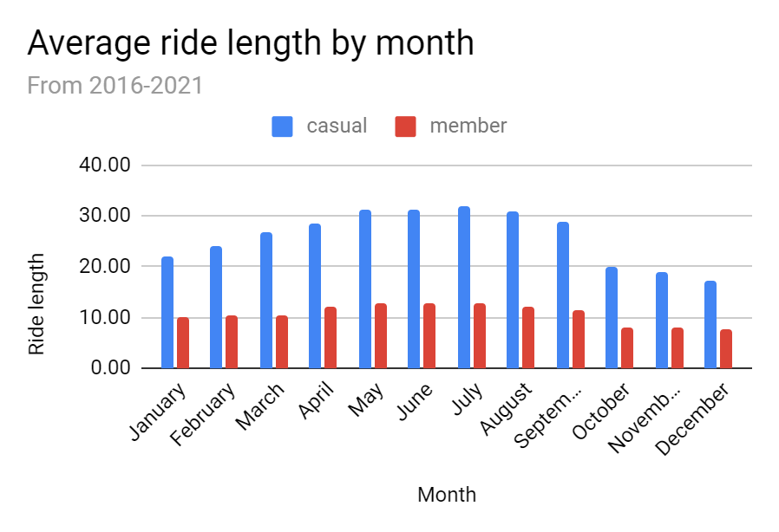
Insights - 3
Analyzing the bike usage by month wise shows that in the mid year the bike usage increases
It’s usually because tourist activities rises in the mid year and more people uses bike for roaming

Slide 8
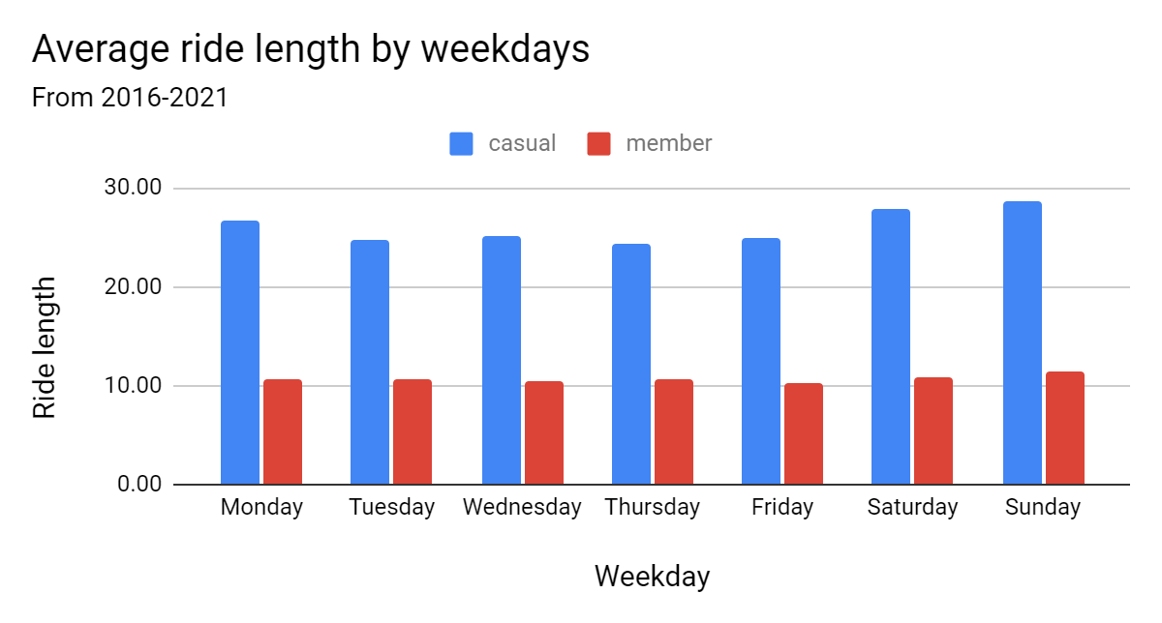
Insights - 4
Overall casual rider uses more bike but especially in the weekends its uses increases slightly
People use more bike because of late night weekends parties or small vacations during weekends

Slide 9
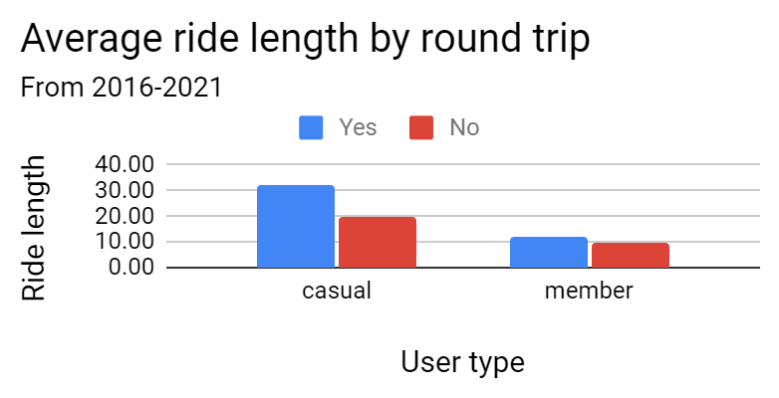
Insights - 5
Casual users take more round trip (means their start station and end station are the same)
Casual user maybe use bike for normal daily routine work like going to the market or going on vacations

Slide 10
Recommendations
Marketing teams should / can -
introduce monthly or quarterly passes so the people will find it more affordable so they will attract towards our annual program
come up with a plan or program for mid year or tourists passes where bike usage increases due to tourists activities
Give discounts or coupons for weekends so people will buy the passes more on weekends thereby relying more on our bikes

Slide 11
Appendix
Cleaning reports (by using R)
2016-17 Cleaning
2017-18 Cleaning
2018-19 Cleaning
2019-20 Cleaning
2020-21 Cleaning
Tableau Dashboard - Click here

Slide 12
Thank You

